Slide 1
Welcome to your initial study pack

Slide 2
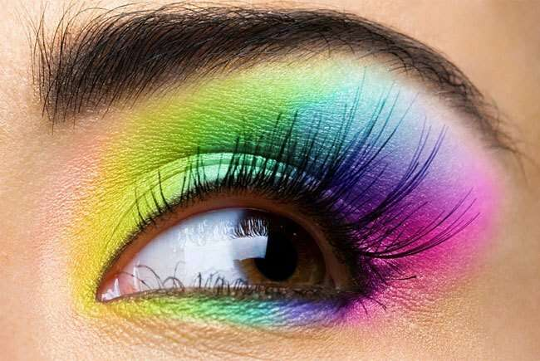
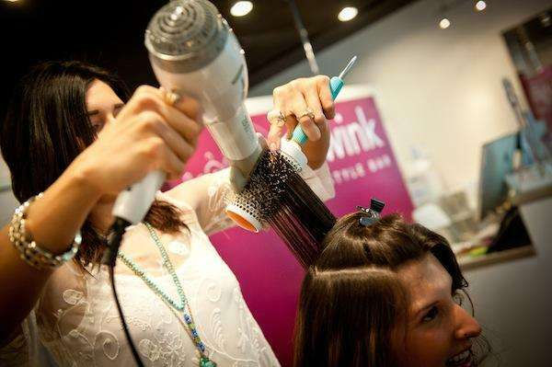
Welcome to hairdressing and beauty therapy. As part of your course you’ll learn lots of different skills and techniques to help you build and fantastic career in the industry. This book will give you an idea of some of the topics you can expect to learn whilst you are studying with us and give you a head start when you begin your studies with us in September. It also includes a bridging assignment for your progression.

Slide 3
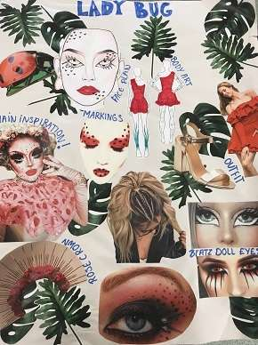
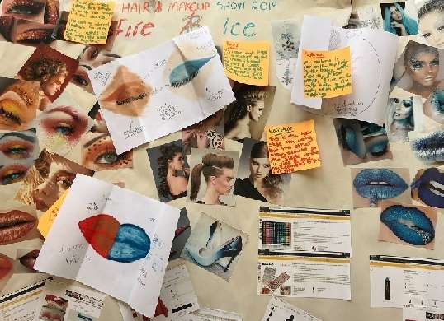
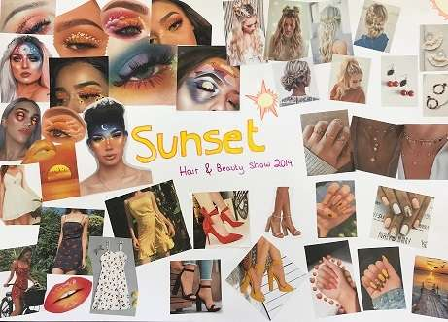
Task 1: Create a mood board

Slide 4
Mood board criteria
The make-up, hair and beauty industry are very creative and you will have to develop your artistic skills to get the most out of your studies.
Part of this bridging assignment requires you to create an image based on a theme.
For this you need to design a mood board, and plan your hair, makeup and nail design.
A mood board is a collection of ideas and images based on a given theme. Design your own mood board based on a theme of your choice.
Some ideas are: Nature - Hollywood - Fantasy - Avant Garde - Historical - Cultural
Take a picture of your finished mood board and send it to us: visions@gcfe.net

Slide 5
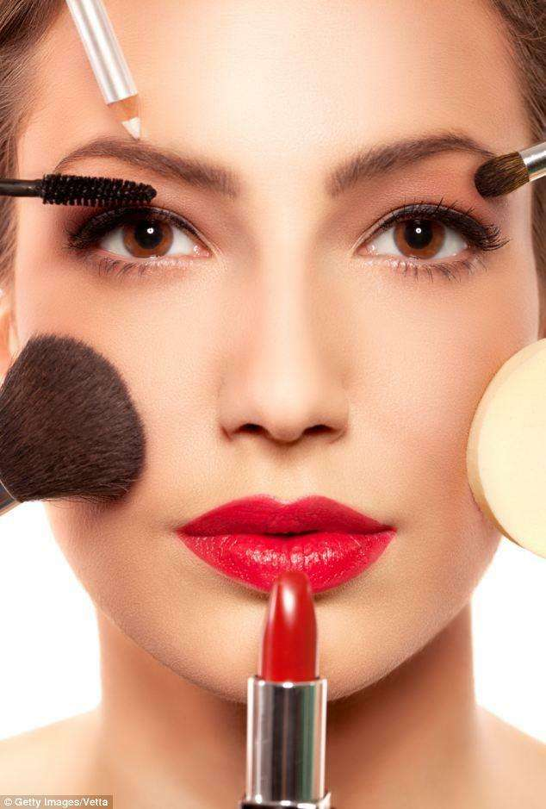
Just for Fun: Test your knowledge
Test your current knowledge of the hair, beauty and make-up industry.
Click on the links below to see what you know – and what you don’t.
https://www.bellusacademy.edu/blog/test-your-beauty-knowledge-take-our-quiz/
https://www.proprofs.com/quiz-school/story.php?title=pp-test-your-cosmetics-knowledge-with-this-quiz
https://play.howstuffworks.com/quiz/makeup-quiz

Slide 6
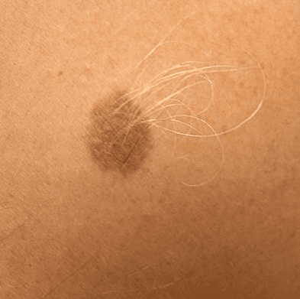
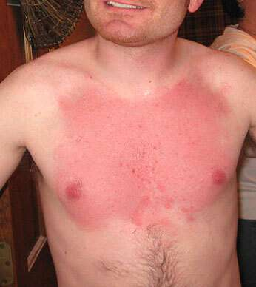
Task 2. COMMON DISORDERS
Find the descriptions that matches the condition name 7 add a picture to complet the condition (they are currently mixed up!)
Use the internet to try and match up the names, pictures and descriptions.
You can colour code the conditions to match up: for example
Condition | Description | Picture
Sunburn | A dark, sometimes raised area of skin.
Moles | The skin will be red, sore and can sometimes have blisters. The skin may be peeling.

Slide 7
Condition | Match up the condition with the name | Find a picture on the internet
Psoriasis | Fungal infection. Starts as a red spot, spreading out and healing from the centre.
Ringworm | Caused by an itch mite. Very itchy. Silvery lines on the skin
Impetigo | Red, itchy, broken and sore skin. Caused by allergies or stress
Scabies | Silvery scales on the skin, most commonly on the elbows, knees and scalp.
Eczema | Red, swollen, itchy. Appears within 24 hours
Allergies | Bacterial infection. Honey coloured crusts

Slide 8
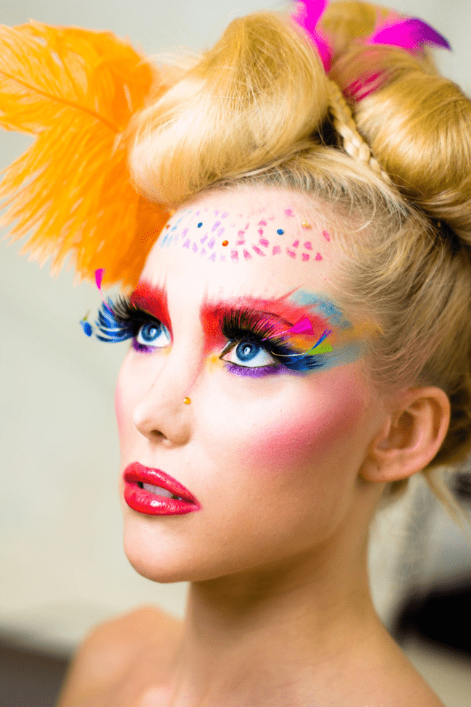
TASK 3: Time to get creative:
Below are some links to a selection of online tutorials Pick a few to watch and practice at home to see if you can replicate the looks. Alternatively, find your own favourite video, replicate that look.
Send us your pictures through: Visions@gcfe.net
Cut crease - https://www.youtube.com/watch?v=NIDltJvgQ3M
Gold cut crease – https://www.youtube.com/watch?v=_uNlGGOgR9E
Smoky eye – https://www.youtube.com/watch?v=NonCmCOimtE
Simple up-dos- https://www.youtube.com/watch?v=bDfw2fbLxqw
Simple nail designs - https://www.youtube.com/watch?v=ElL895fr_Jg

Slide 9
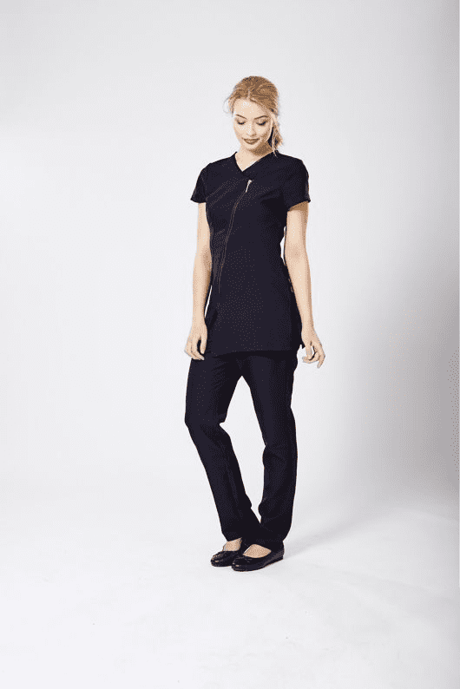
Task 4: Salon ethics & personal presentation
Create a poster showing how a beauty therapist should present themselves whilst working in a salon environment to include:
Hair, nails, makeup & personal hygiene
Uniform
How they should conduct themselves (behaviour & attitude)
What hygiene they should abide by

Slide 10
Thank you
We hope you enjoy completing this introduction into what to expect at college & we look forward to welcoming you on campus.
If you have any questions please don't hesitate to ask and contact one of the tutors:
Mark Rayment: mrayment@gcfe.net - Hairdressing
Claire Monti: clairem@gcfe.net - Hairdressing
Ali Black: alib@gcfe.net - Beauty Therapy
Becky Ellis: rebeccae@gcfe.net - Beauty Therapy
Guernsey College Of Further Education: Les Ozouets Campus, Les Ozouets, St. Peter Port, Guernsey, GY1 2UB

